Slide 1
Mahjong Hand Analyzer
Consult with us on your mahjong tiles in hands and get advice to win.
By Chung Zhi Wei

Slide 2
The Problem
When playing mahjong, you would come across some hands that seems messy. To add on to that some games have house rules and minimum points making your hand that looks like its complete to be invalid.
Non experienced people would look at their hand and ask what should I do? Well that is where this app comes in, to give you advice on what to do.
The reason for using AI is that this game does have many ways to win and we want to give other options rather than just one calculated route.

Slide 3
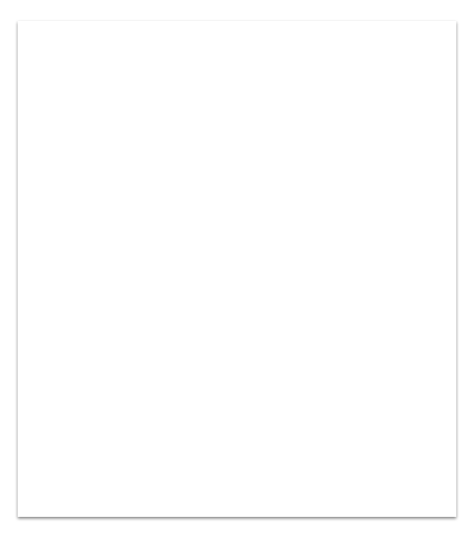
How it works
1. User fills out information on what is in their hand and what the current rules are.
2. After reviewing their input the user press analyze.
3. Here is where the app takes in the input and builds a prompt.
4. Once the prompt is built it sends it over to the AI API.
5. Once the AI API returns with its output, display it for the user.

Slide 4
Live Demo!

Slide 5
What I learned
Some knowledge are not present in the model. For this case, mahjong is not known by llama. I tried other llama models and they all did not know what mahjong is. Only when I switch model does it finally know what mahjong is.
If I could do anything differently it would be the UI. I went to make the UI neat and tidy but when bringing it to the game, it takes some time to key in the tiles.
What feature to add next would be adding the tiles discarded to the analysis.

Slide 6
Thank You!

